Slide 1

Tableau
Layout, Interaction, Percentages and IF Statements
Interactive Media Design & Visualisation

Slide 2
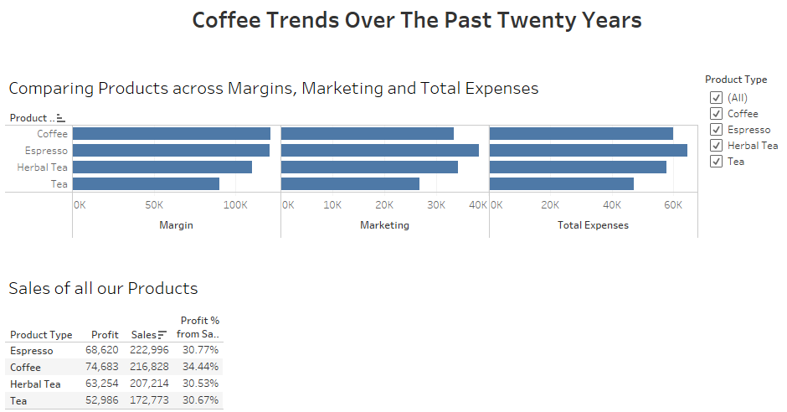
Layout

Slide 3
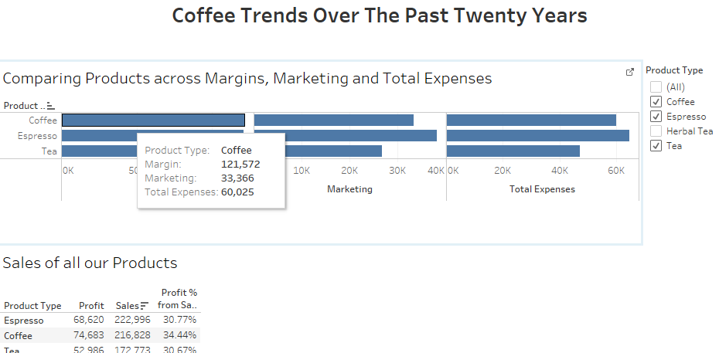
Rollover – add to it!

Slide 4
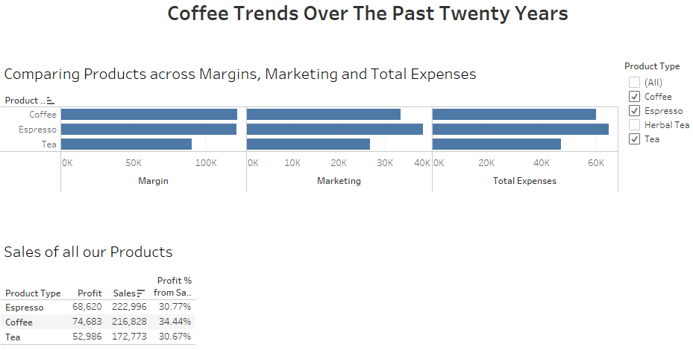
Interaction within the dashboard
http://kb.tableau.com/articles/knowledgebase/action-quick-filter-sync

Slide 5
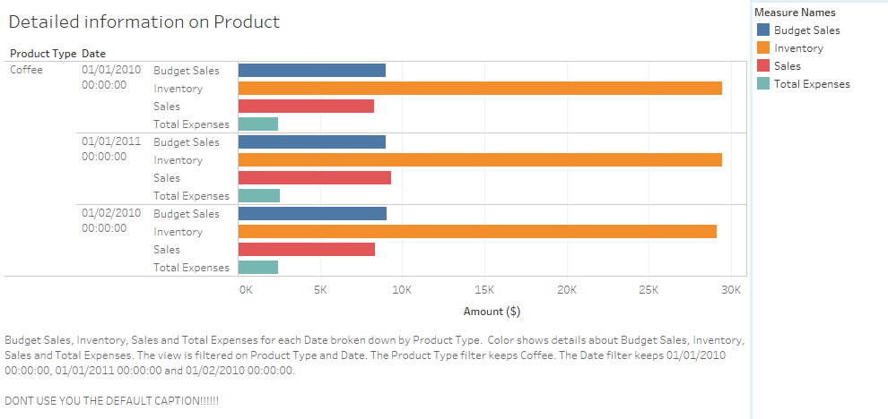
Interaction to another dashboard
So I have clicked on Coffee on the main dashboard

Slide 6
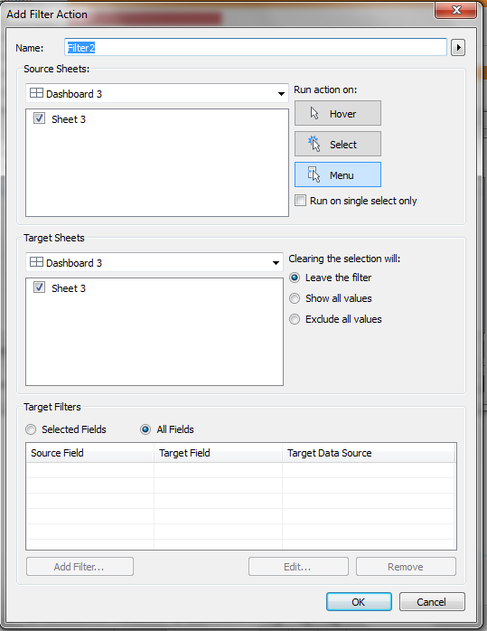
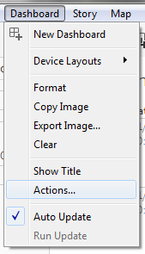
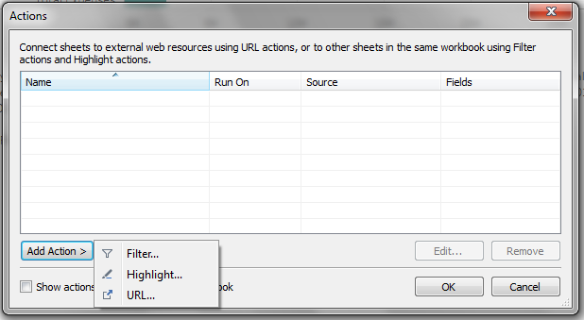
Interaction – How to

Slide 7
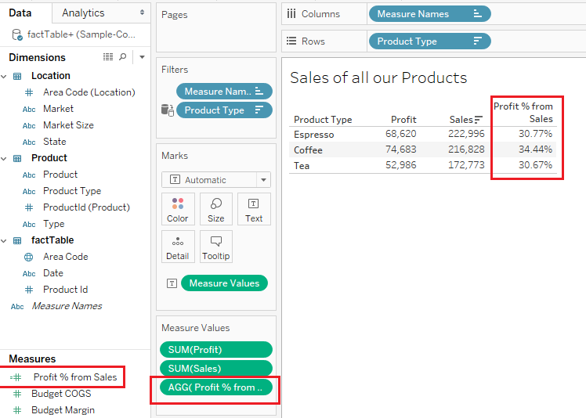
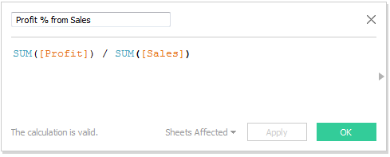
Add Percentages

Slide 8
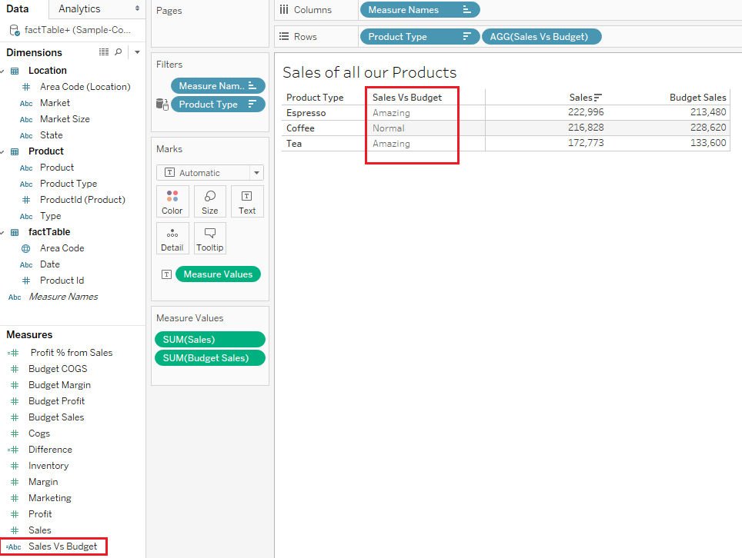
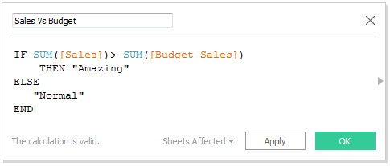
IF Statements

Slide 9
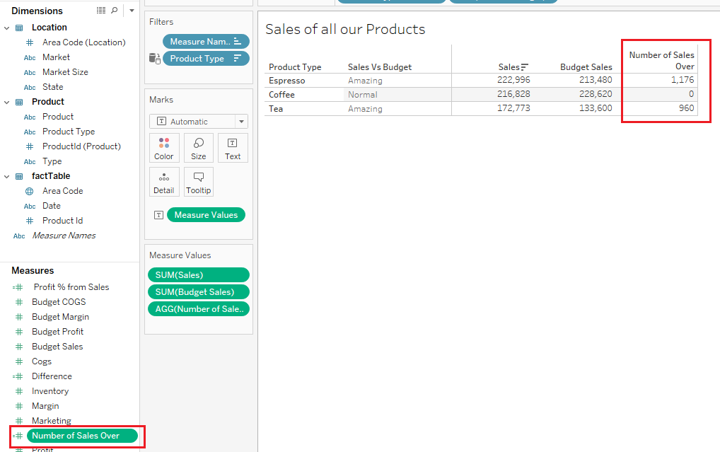
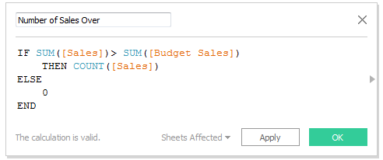
IF Statements

